Slide 1
Adjusting the portable mounds on Crockett fields 5 & 6

Slide 2
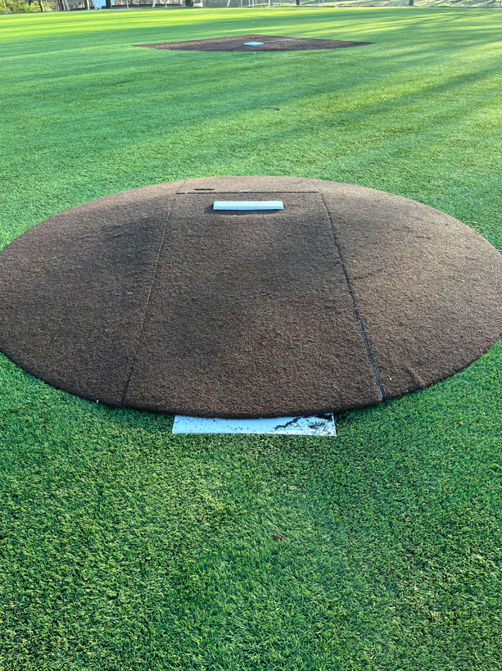
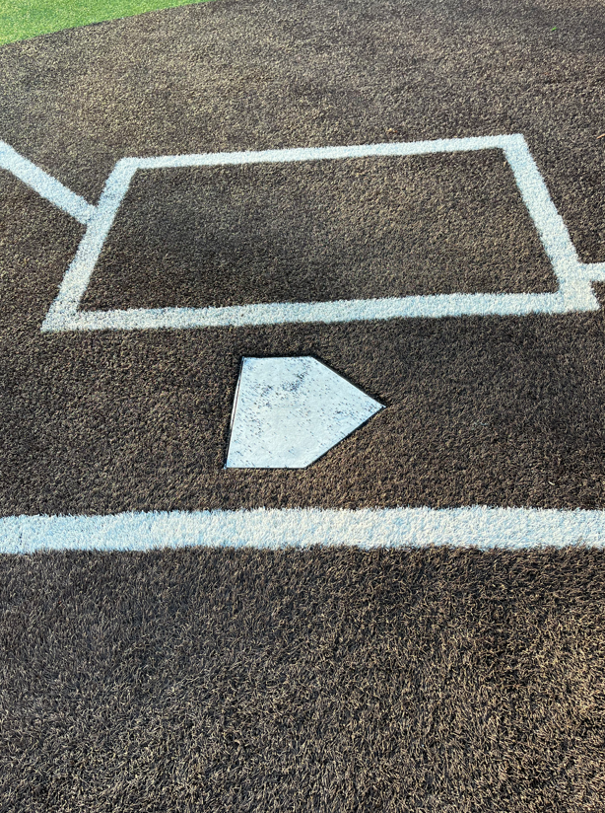
Back of home plate
Fields 5 & 6 contain a 4-piece mound that is movable
Piece 2
Elevated mound rubber
Piece 3
Piece 1
Piece 4
9/10YO distance = 46’
11/12YO distance = 50’
Distance is measured from back of home plate to the front of the elevated mound rubber (Piece 4).
We keep a measuring tape in the concession stand, accessible when concessions are open.
If the front of the mound is sitting on the middle of the rubber as shown above, the mound distance is just short for 11/12YO baseball. Need to see entire rubber for 50’. The center of the rubber to home plate is 43.5’.

Slide 3
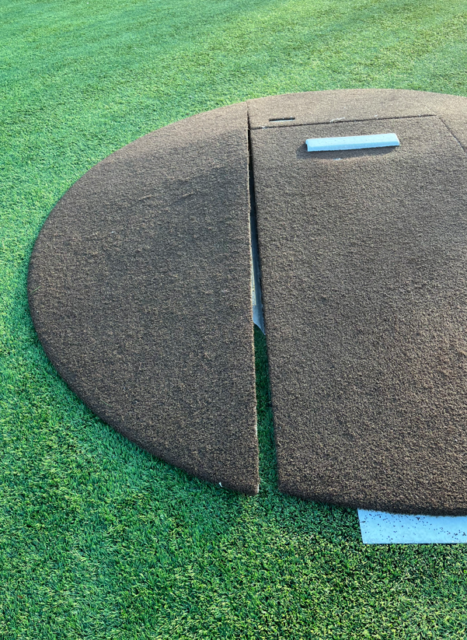
Step 2 Slightly lift up the back edge of Piece 1 & separate
To adjust the mound distance, follow these steps
Piece 1
Piece 1
Step 1 Slightly lift up the front edge of Piece 1 & separate as shown

Slide 4
Step 3 Move Piece 3 front & back as Piece 1 was moved to separate
Piece 2
Piece 2
Piece 3
Piece 3
Piece 1
Piece 4
Step 4 Lift up and pull Piece 2 (lightest of the 4 pieces) back a few feet
Step 5 Slide Piece 4 up or back depending on the needed distance. Reattach all pieces.

